Slide 1

Optimistic Optimization for
Statistical Model Checking with
Regret Bounds
Negin Musavi¹, Dawei Sun¹, Sayan Mitra¹, Geir Dullerud¹, and Sanjay Shakkottai²
¹University of Illinois at Urbana Champaign
²University of Texas at Austin
October 2019
Notes:
Hello, everyone. My project is about statistical model checking. In this project, we model a class of statistical model checking problem as a zeroth black box optimization problem. We use optimistic optimization algorithms to solve this problem.

Slide 2


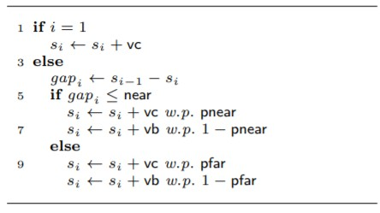

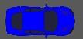




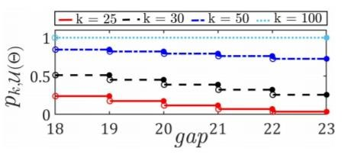
Platoon of 𝑚 Cars on a Single Lane (Brake and Cruise Modes)
Transition Model Platoon of 𝑚 Cars on a Single Lane
Car 𝑚 Car 4 Car 3 Car 2 Car 1
…
brake
𝑠_{𝑚}
𝑠₂
𝑠
1
Probability of Hitting the Unsafe Set
An Unsafe Scenario
Car 𝑚
Car 4
Car 3 Car 2
Car 1
…
brake
^{𝒈𝒂𝒑}𝟐 ^{≤ 𝜹}𝒖𝒏𝒔𝒂𝒇𝒆
Figure 1. Platoon of 2 cars
2
Notes:
First, let’s look at an example. We have a platoon of m cars on a single lane. This a synchronized model. For each car, the transition logics is like this. For each car, at every time step, there are two possible values for the velocity. The car choose its velocity stochastically. The probability distribution is determined according to the distance to the predecessor. For example, if the distance is large, the car will choose the higher velocity with a higher probability. The leading car has a constant velocity. If there is a car that is too close to the predecessor, we say the system is unsafe. What we care about is the probability of reaching the unsafe set from a initial state, and from which initial state this probability is maximized.

Slide 3
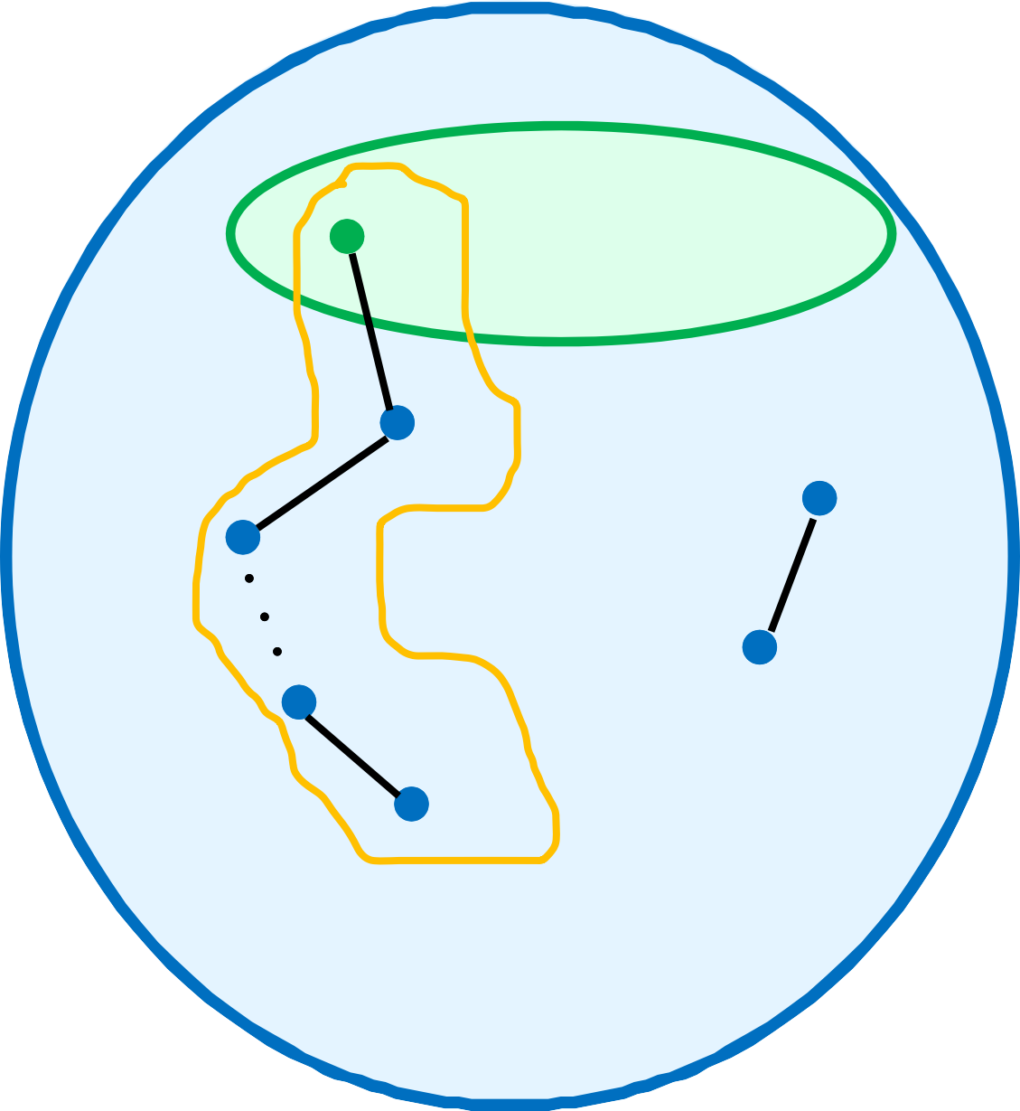
Nondeterministically Initialized Markov Chains (NiMC)
NiMC, ℳ is defined by 𝒳, Θ, Ρ :
𝒳 = ℝ^{𝑚} is the state space;
Θ ⊆ 𝒳 is the set of initial states;
Ρ ∶ 𝒳 → ℙ 𝒳 is the probability transition function.
𝒳
Θ
𝑥₀
𝑥₁
For states 𝑥, 𝑥′ ∈ 𝒳, let Ρ be the
𝑥
𝑥,𝑥′
probability of transitioning from state 𝑥
to 𝑥′.
𝑥₂
^{Ρ}𝑥,𝑥′
𝑥′
^{𝑥}𝑘−1
𝑥_{𝑘}
For state 𝑥₀ ∈ Θ, let 𝛼 = 𝑥₀, 𝑥₁, … , 𝑥_{𝑘}
be the execution of length 𝑘 with
𝛼
probability 𝑝 𝛼
3
Notes:
This is the mathematical formulation of our problem. Nondeterministically initialized Markov Chains, NiMC. An NiMC M is definied by a triple. The state space X the initial state space theta and the probability transition matrix P. An execution of the system starts from a state in Theta and follows the transition matrix P up to a time horizon k. k is just the length of the execution.

Slide 4
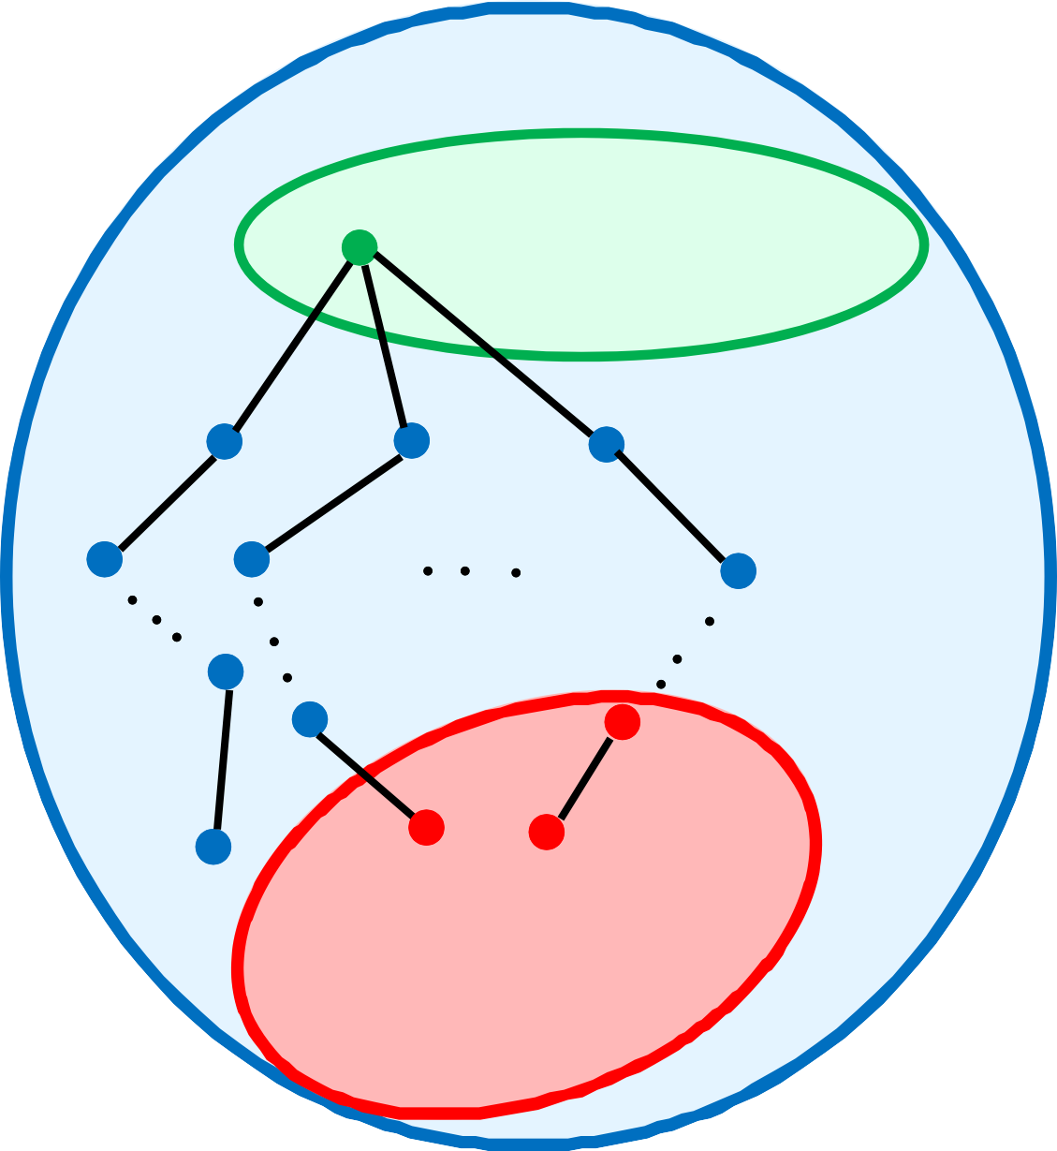
Nondeterministically Initialized Markov Chains (NiMC)
Let 𝐸𝑥𝑒𝑐𝑠_{𝑥0} (𝑘) be set of all length 𝑘
executions of ℳ starting from 𝑥₀ ∈ Θ.
Let 𝒰 ⊆ 𝒳 be the set of unsafe states.
An execution 𝛼 hits the unsafe set if there exists a 𝑥 ∈ 𝛼 such that 𝑥 ∈ 𝒰.
𝒳
Θ
𝑥₀
Let 𝐸𝑥𝑒𝑐𝑠_{𝑥0} (𝑘, 𝒰) be set of all length 𝑘 executions of ℳ starting from 𝑥₀ ∈ Θ that hit 𝒰.
𝒰
𝑥
𝑥_{𝑘}
𝑘
𝑥_{𝑘}
Let 𝑝_{𝑘,𝒰}(𝑥₀) be the probability of ℳ
hitting 𝒰 within 𝑘 steps
4
Notes:
Then we define another subset of the state space, the unsafe set u. And we use pku(x_0) to denote the probability of reaching the unsafe set u with a time horizon k starting from a state x_0.

Slide 5
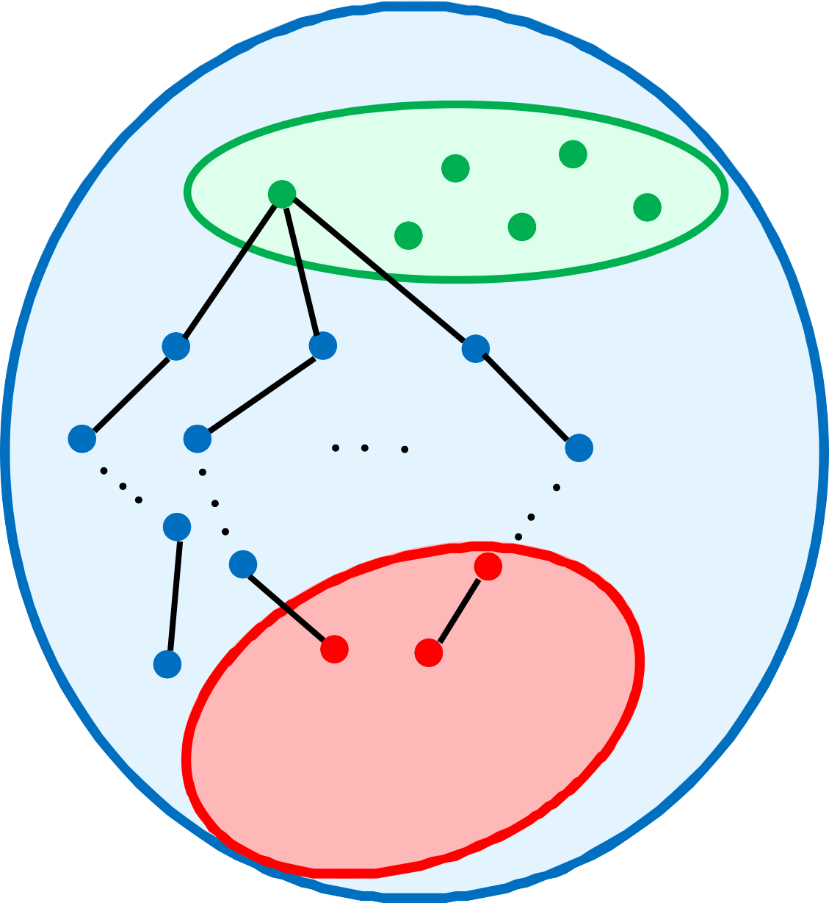
Nondeterministically Initialized Markov Chains (NiMC)
What is max 𝑝_{𝑘,𝒰}(𝑥₀) ?
𝑥₀∈Θ
𝒳
Θ
This is an optimization problem where we do not know the model completely.
Here the probability transition matrix Ρ
is unknown.
We use black-box optimization methods
to solve this problem
𝑥₀
𝒰
𝑥_{𝑘}
𝑥
𝑥_{𝑘}
𝑘
5
Notes:
The most interesting verification problem for this system, is this we want to know the worst initial state x_0 from which the probability is maximized. Obviously, this is an optimization problem. The objective is this function. However, we do not have the analytical form of this function. It is a black box for us. We only have the input-output relationship at a single point. In other words, given a x_0 we can evaluate the value of this objective function. Furthermore, this evaluation is nor accurate. This p_ku(x_0) is a deterministic function. But when evaluating the value we only have a bunch of samples from a Ber distribution which mean is p_ku(x_0). So if we want to know the exact value of this function, we need infinite many samples. Of course it is not possible in practice. This problem is exactly a multiarmed bandit problem, a very famous model in blackbox optimization. For this model, many good algorithms have been developed, which are known as blackbox optimization methods.

Slide 6
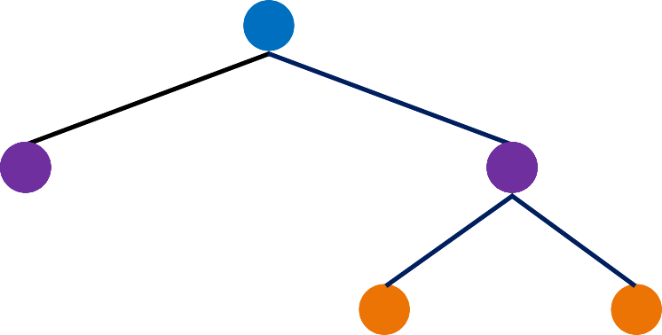
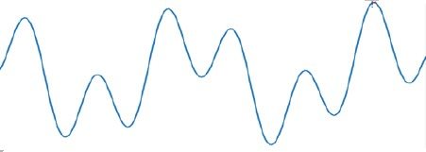
Hierarchal Partitioning
Each node n the tree is denoted by pair (ℎ, 𝑖)
At each depth ℎ: 𝑖 ∈ 1, … , 2^{ℎ}
Each node corresponds to a region
𝒫_{ℎ,𝑖} ∈ 𝒳
𝑖
(0,1)
(1,1)
(1,2)
ℎ
(2,3)
(2,4)
11
^{𝒫} 2,3 ^{𝒫} 2,4
^{𝒫} 1,2
^{𝒫} 1,1
^{𝒫} 0,1
Notes:
Many successful algorithms for this problem are based on hierarchal partitioning. The idea is simple, we continue to partition the domain of input. And we construct a tree, which nodes correspond to partitions of the domain. This node refer to the whole domain, and then we add some children nodes to this node. This one refer to the left half of the domain and this one refer to the right half. We continue to do this and partition the domain into smaller and smaller cells. For each cell, we choose a point in this cell and evaluate the function at this point. Then we use this value as an representative of this cell, we use this value as an assessment of this whole cell. These values will be used when deciding which cell to partition next. As we keep partitioning, the cell gets smaller and smaller, and this approximation gets more and more accurate. If we make some assumptions about the smoothness of the function, we can get an error bound of this approximation. That is the general idea behind this class of methods.

Slide 7
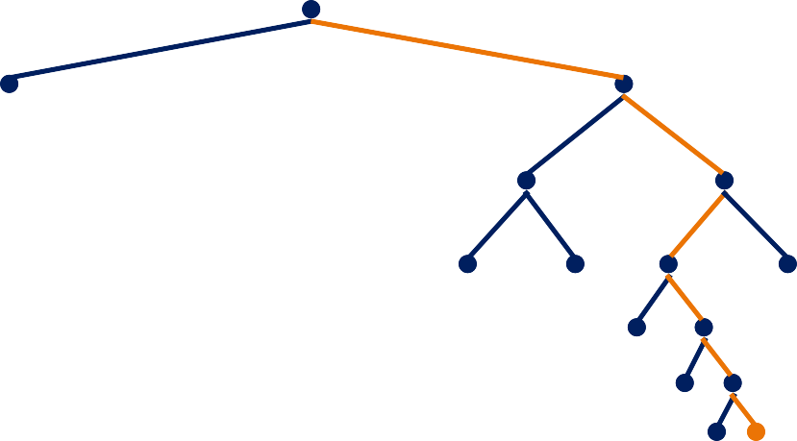
MFHOO Algorithm Illustrations
Algorithm Inputs: Λ, 𝜁 . , 𝜆 . , (𝜐, 𝜌)
At each round 𝑛, each node (ℎ, 𝑖) maintains
the following values:
path
𝑐𝑜𝑢𝑛𝑡_{ℎ,𝑖} = # times the node is traversed
𝑓^{መ} 𝑓^{መ}
← 1 − 𝑐𝑜𝑢𝑛𝑡 + 𝑦Τ𝑐𝑜𝑢𝑛𝑡
ℎ,𝑖 ℎ,𝑖 ℎ,𝑖
ℎ,𝑖
tree
2
𝑈_{ℎ,𝑖} ← 𝑓^{መ} +
ℎ,𝑖
2𝜎 log(𝑛)
ℎ
+ 𝜐𝜌 + 𝜁(𝑧 )
𝑐𝑜𝑢𝑛𝑡_{ℎ,𝑖}
ℎ
𝒫
6,56
Point 𝑥 ∈ 𝒫_{6,56} is chosen
Reward 𝑦 is received by evaluating at fidelity 𝑧_{ℎ} = 𝜁⁻¹(𝜐𝜌^{ℎ})
𝐵 ← min{𝑈 , max{𝐵
, 𝐵 }}
ℎ,𝑖
ℎ,𝑖
ℎ+1,2𝑖−1 ℎ+1,2𝑖
12
Notes:
What we actually used is the MFHOO algorithm, multi fidelity hierarchal optimistic optimization. Multi fidelity mans we can evaluate the function up to different fidelities. In our case, fidelity is just how many simulation steps we use to evaluate the probability.

Slide 8
Multi-fidelity Bias Function - Theorem
Proposition 1
Let 𝑁 = σ∞ 𝑄^{𝑗} =
𝐼 − 𝑄 ⁻¹. Suppose 𝐵 = 𝑁𝑅. Then 𝐵_{𝑖𝑗} is the probability that starting
𝑗=0
from a transient state 𝑠_{𝑖} the chain will be absorbed in state 𝑠_{𝑗} ∈ 𝒰.
We now state the following theorem.
Theorem 2
For any 𝑥₀ ∈ Θ and any time horizon 𝑘 < 𝑘_{𝑚𝑎𝑥},
𝜅∞(𝐸)(𝑘_{𝑚𝑎𝑥} − 𝑘)
|𝑝
𝑥 − 𝑝 (𝑥 )| ≤
𝑘_{𝑚𝑎𝑥},𝒰 0
𝑘,𝒰 0
(𝑘_{𝑚𝑎𝑥} − (𝑘_{𝑚𝑎𝑥} − 1)𝜆_{𝑚𝑎𝑥})(𝑘 − (𝑘 − 1)𝜆_{𝑚𝑎𝑥})
where 𝜆_{𝑚𝑎𝑥} is the maximum eigenvalue, 𝐸 is the matrix of eigenvectors of the matrix 𝑄,
and 𝜅∞(𝐸) is the (∞-norm) condition number of 𝐸.
19
Notes:
Using lower fidelity will cause some error or bias on the evaluation. So we give a bound on the error. P_kmax means the evaluation using longest time horizon. If we use a shorter time horizon k to approximate this value, the error is bounded by this expression. We also have some other good theoretical results. But that is totally Negin’s contribution instead of mine. So I will not go through the details of the theoretical results. If you are interested, you can find that in our paper.

Slide 9
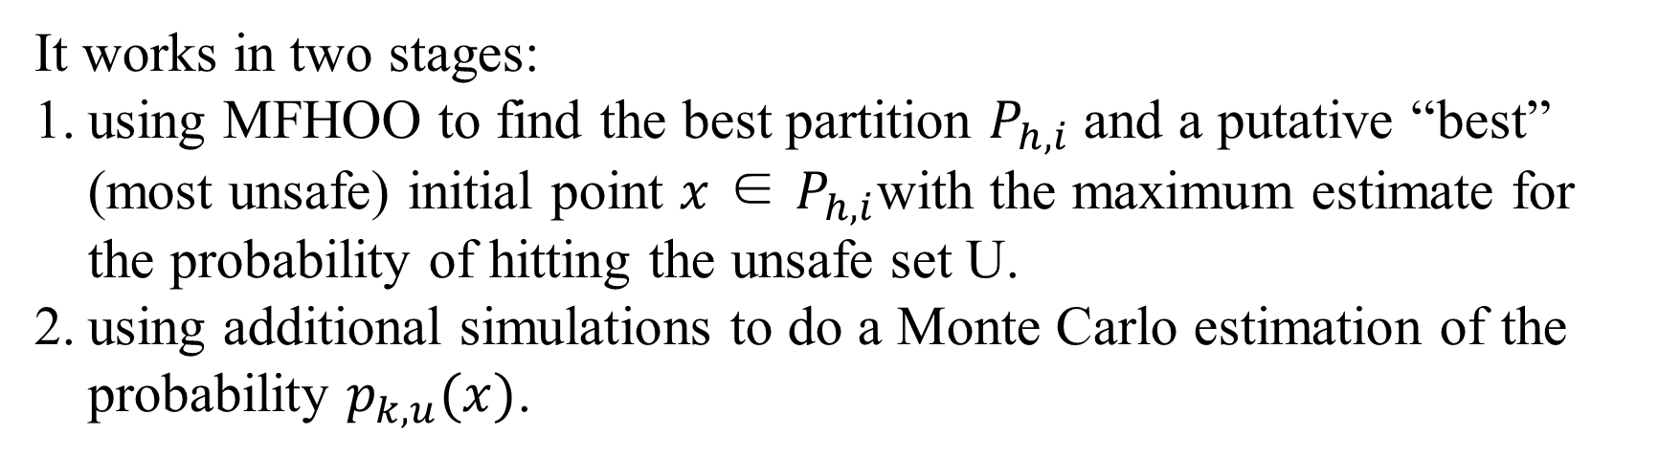
HooVer: A Statistical model checking tool for NiMC
https://github.com/sundw2014/HooVer
It works in two stages:
using MFHOO to find the best partition $P_{h,i}$ and a putative “best” (most unsafe) initial point $x$ ∈ $P_{h,i}$with the maximum estimate for the probability of hitting the unsafe set U.
using additional simulations to do a Monte Carlo estimation of the probability $p_{k,u}(x)$.
30
Notes:
We have implemented a prototype tool called HooVer which uses MFHOO to solve SMC problems for NiMC. We compare the performance of HooVer with other SMC model checkers on several benchmarks we have created. You can find this tool on Github. This tool works in two stages. First, it uses MFHOO to do a black box optimization and find the best partition and a putative best point (best means most unsafe) x in this partition from which the estimated probability is maximized. Then it uses additional simulations to do a Monte Carlo estimation of the probability for this point x.

Slide 10


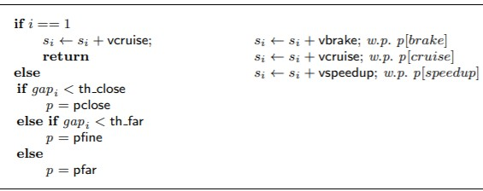
Platoon of 𝑚 Cars on a Single Lane (Brake, Cruise and Speed-up)
Transition Model Platoon of 5 Cars on a Single Lane
Car 𝑚 Car 4 Car 3 Car 2 Car 1
…
cruise
𝑠₅
𝑠₂
𝑠
1
An Unsafe Scenario
Car 𝑚
Car 4
Car 3 Car 2
Car 1
…
cruise
^{𝒈𝒂𝒑}𝟐 ^{≤ 𝜹}𝒖𝒏𝒔𝒂𝒇𝒆
30
Notes:
In order to evaluate our tool and algorithm and compare it to other model checkers, we created some benchmarks from scratch. This one is a platoon of m cars on a single lane. For each car, there are three possible values for the velocity. Each car choose it velocity stochastically. Corresponding to different distance to the predecessor, we have three different probability distributions of the velocity, which refer to three modes. Brake mode, Cruise mode and speed-up mode. For example, if the car is a little bit far from the predecessor, it will choose a higher velocity with a higher probability. If there is car which is too close to its predecessor, we say the system is unsafe.

Slide 11

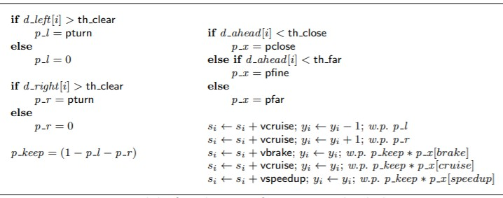
Platoon of 𝑚 Cars on Multi-Lane (Brake, Cruise and Speed-up)
𝑠_{𝑖}
_{𝑦}Car 𝑚
Car 4
Car 3
Car 2
Car 1
𝑖
…
cruise
Transition Model
Lane 1
Lane 2
cruise
Lane 3
cruise
Notes:
And there is another more complicated model, based on the last model. In this model, the cars can choose to change its lane. The unsafe set is defined similarly. The state space of this model is larger than the last one.

Slide 12
Workload for Each Benchmark
For each benchmark:
Define the formal transition rules
Implement a simulator in Python
Create an equivalent PRISM model
Check the equivalence
Rescale the model (please refer to the paper for details)
31
Notes:
For each benchmark, First we
PRISM is a very commonly used language for modeling stochastic models. Many statistical model checkers support the Prism language. So, we implement each benchmark in Prism language, and then we check the equivalence between the Prism implementation and the Python implementation by calculating and comparing the probability at some sampled initial points.

Slide 13
Discretizing and Rescaling the Benchmarks
HooVer is for continuous state spaces, however most model checking tools are designed for discrete state spaces only
HooVer keeps partitioning Θ hierarchically and stops at a depth h, which can be considered as searching over all the 2h partitions at depth h
31
Notes:
HooVer is designed for continuous state spaces, however most model checking tools are designed for discrete state spaces only. They don’t support continuous state space models. However, our benchmarks are defined on continuous spaces. In order to make a fair comparison, we have to discretize the continuous model and make sure that the discrete version is as hard as the continuous version. We noticed that in HooVer, it keeps partitioning Θ hierarchically and stops at a depth h, which can be considered as searching over all the 2h partitions at depth h. The idea is, in order to make a fair comparison, we make sure that the discrete version of the benchmark has $2^{h}$ initial states.

Slide 14
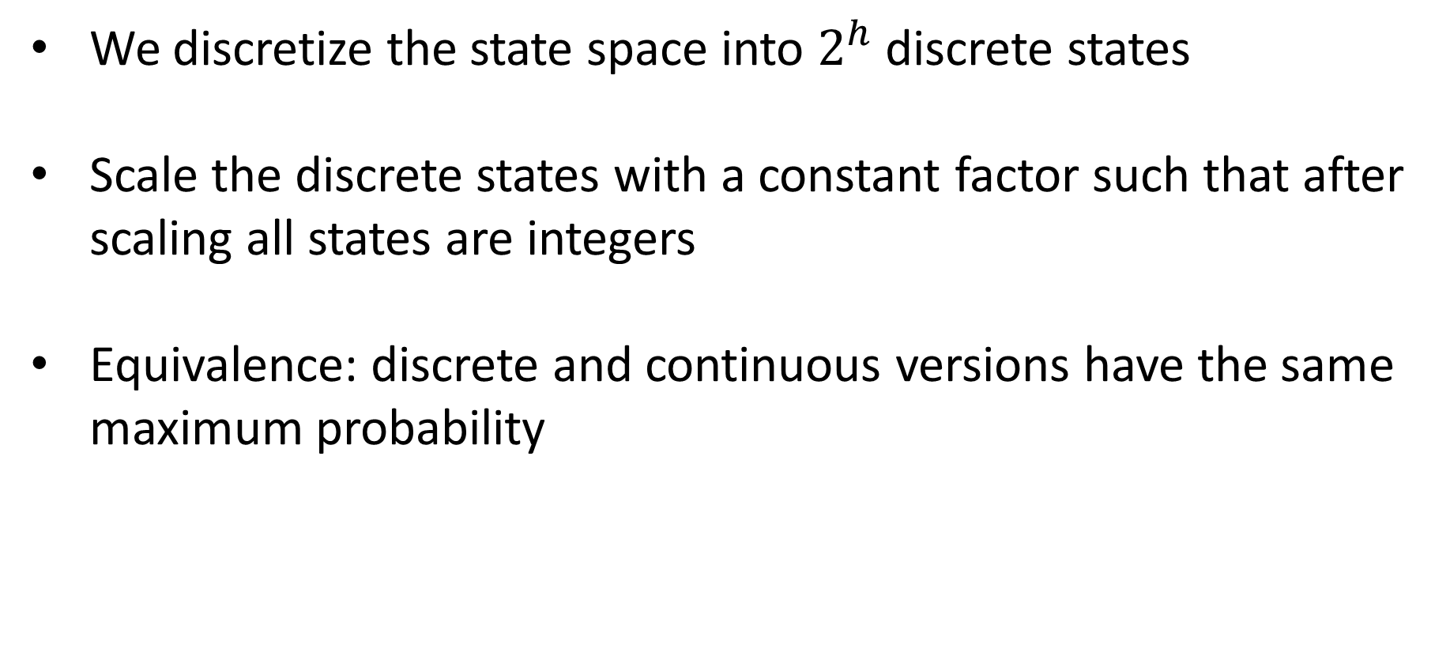
Discretizing and Rescaling the Benchmarks
We discretize the state space into $2^{h}$ discrete states
Scale the discrete states with a constant factor such that after scaling all states are integers
Equivalence: discrete and continuous versions have the same maximum probability
31
Notes:
In order to make a fair comparison, we discretize the state space into $2^{h}$ initial states. After that we also do a scaling operation to make sure that the initial states in theta are all integers. We can also prove that the discrete version and the continuous version are equivalent. They have the same maximum probability of reaching unsafe set.

Slide 15
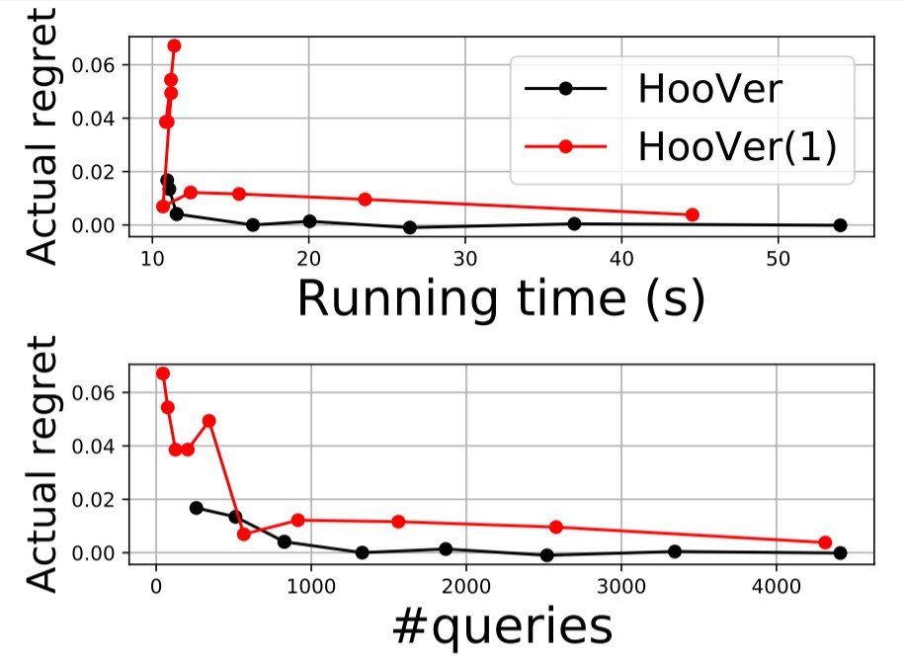
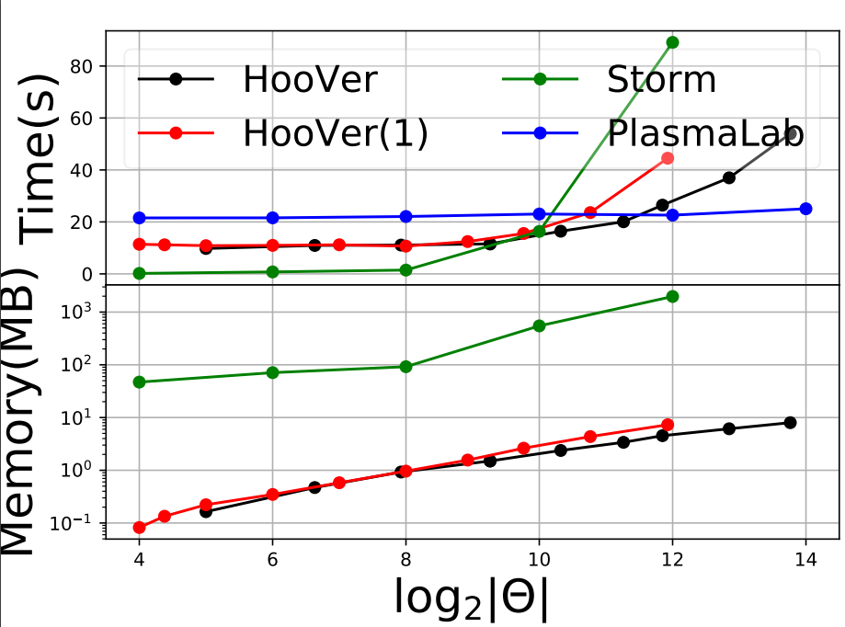
Platoon of 𝑚 Cars on a Single Lane (Brake, Cruise and Speed-up)
Figure 3. Platoon of 2 cars on a single lane. Comparison between the performance of the full fidelity case (HooVer(1)) and the multi fidelity case (HooVer)
Figure 4. Platoon of 2 cars on a single lane. Comparison between the performance of HooVer(1), HooVer, Storm, and PlasmaLab.
31
Notes:
There are some results. This figure clear shows that multi-fidelity is more sample efficient than the full fidelity version. This figure is the comparison with other model checkers. The results show our tool is more efficient compared to probabilistic model checkers like Storm. And the result is comparable, compared with statistical model checkers like PlasmaLab.

Slide 16
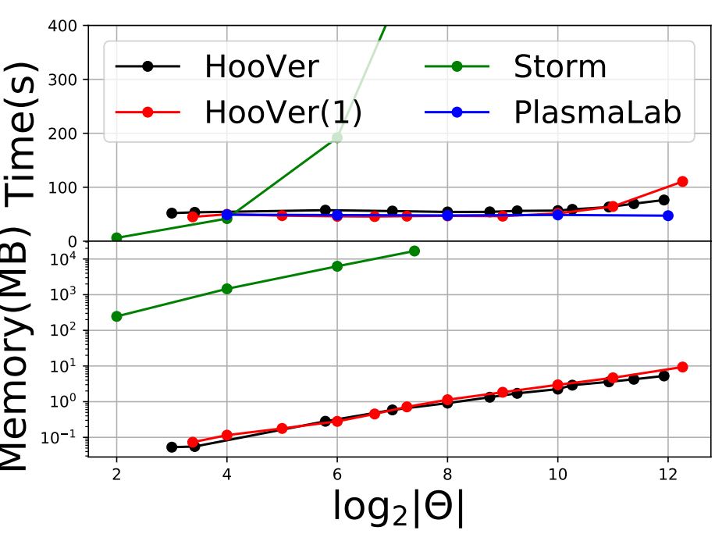
Platoon of 𝑚 Cars on Multi-Lane (Brake, Cruise and Speed-up)
Figure 5. Platoon of 2 cars on 2 lanes. Comparison between the performance of HooVer(1), HooVer, Storm, and PlasmaLab.
Notes:
This is the result for another benchmark. The result is similar.

Slide 17
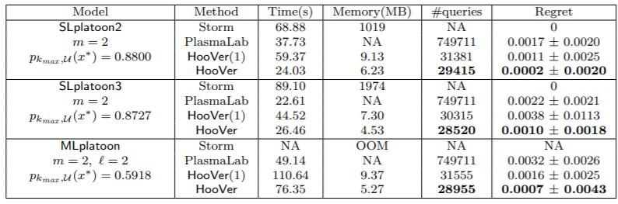
Results
Table 1. Comparison between the performance of HooVer(1), HooVer, Storm,
and PlasmaLab.
Notes:
There are some quantative results. We can see that for this benchmark, Storm failed to check it due to the memory limitation. Compared with PlasmaLab, our method requires more running time. However, we note that PlasmaLab is a considerably more mature tool, which is highly optimized. So it’s not fair to compare the running time directly. Another metric is the number of queries, which means how many simulation are needed for checking this model. We can see that compared to PlasmaLab, our method requires much fewer queries to reach comparable regrets, which verify the sample efficiency of our method.

